Slide 1
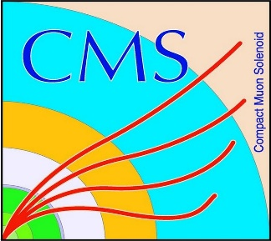

HEP Weekly Report
George Bakas
NTUA

Slide 2
Progress Report
DCS
Working on a change in the ownership of the Control Units of the FSM
Every Control Unit in the FSM of CMS has an owner
Sometimes when shifters change→ some Control Units are still owned from the previous shifter
There was a need that we can change by hand the ownership giving the new shifter the whole ownership of the FSM
Getting my hands on the DB editor and Navigator DEV
Set of Panels that let you recreate a project that exists in the production. Send directly a set of instructions/arguments to a specific system to be recreated there
Get to fix some bugs
Remove Wiener Crates that are not working form central 3 project
Master Thesis: uploaded my master thesis

Slide 3
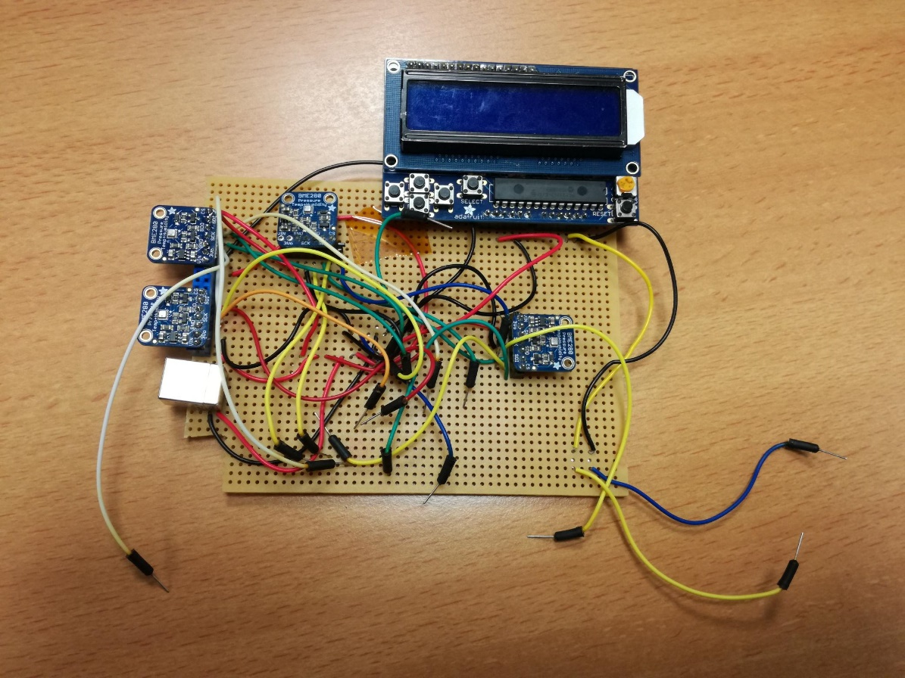
ArdEnvino
Completed the make of a project Board that matches the exact schematic of the version 2: problem when I use 4 sensors
Checked with Florian:
Tried to fix the problem with several ways
Not a hardware problem probably
Will try using Hardware SPI on the Arduino mega.
Will recreate that using a breadboard (was actually brought yesterday at the lab)
Arduino is powered from 1 power source
All of externals (BMES,screen) are powered by external power
There is a common ground between the Arduino and the external power
4 BME280 Sensors
External Power USB B

